Slide 1
Best practices in Windows App Development
Tom Verhoeff
Methylium
mail@tomverhoeff.nl
http://blog.tomverhoeff.nl
@tomverhoeff

Slide 2


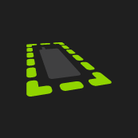


About me…
Delft University of Technology
Methylium

Slide 3
Metro Design
Metro style design
Fast and fluid
Snap and scale beautifully
Use the right contracts
Invest in a great Tile
Feel connected & alive
Roam to the cloud
Embrace Metro principles

Slide 4
Agenda
Design & Form factors
Screen sizes
Input methods
Semantic Zoom
Contracts
Live Tiles
...

Slide 5
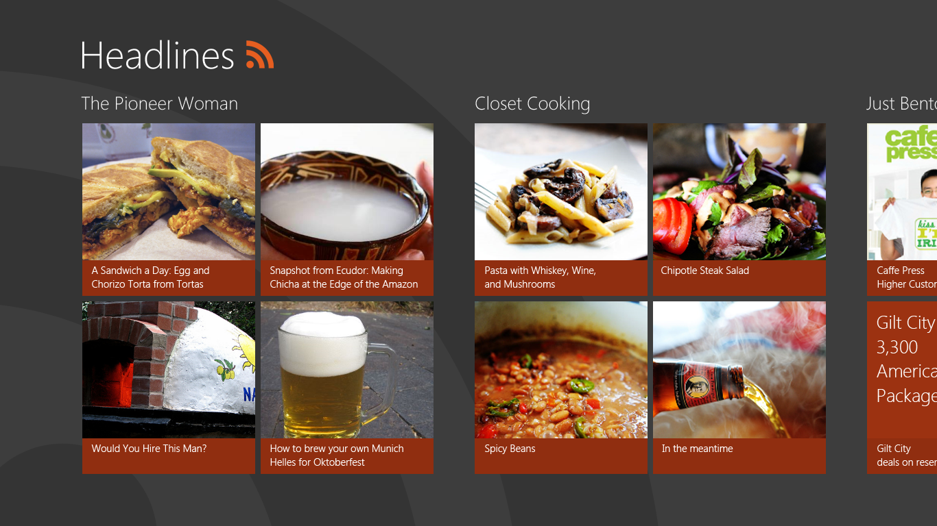
Metro Design

Slide 6
Metro Design

Slide 7
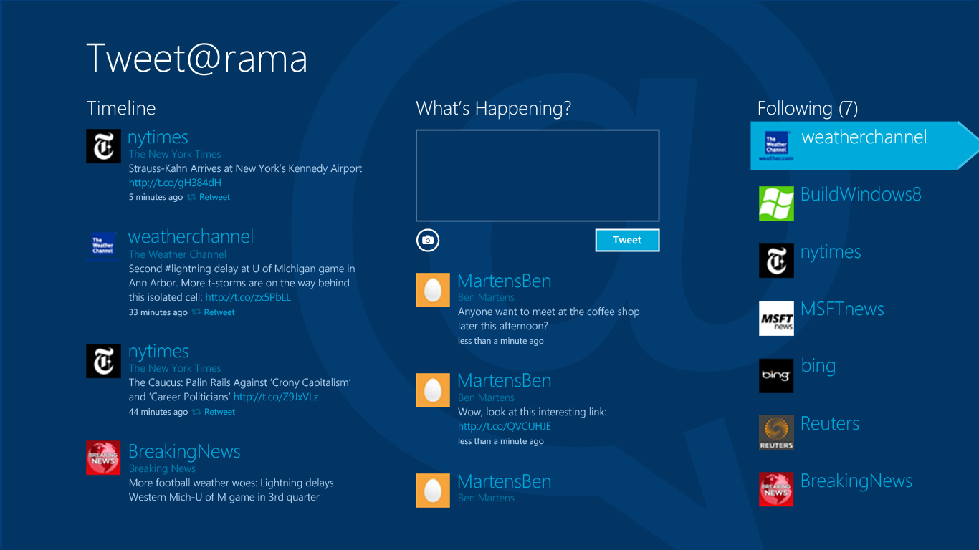
Metro Design

Slide 8
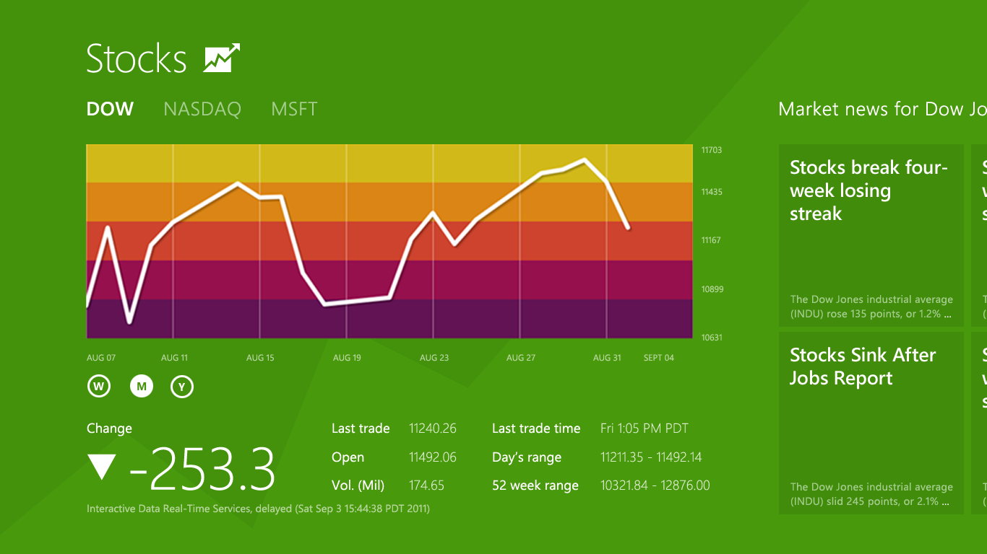
Agenda

Slide 9
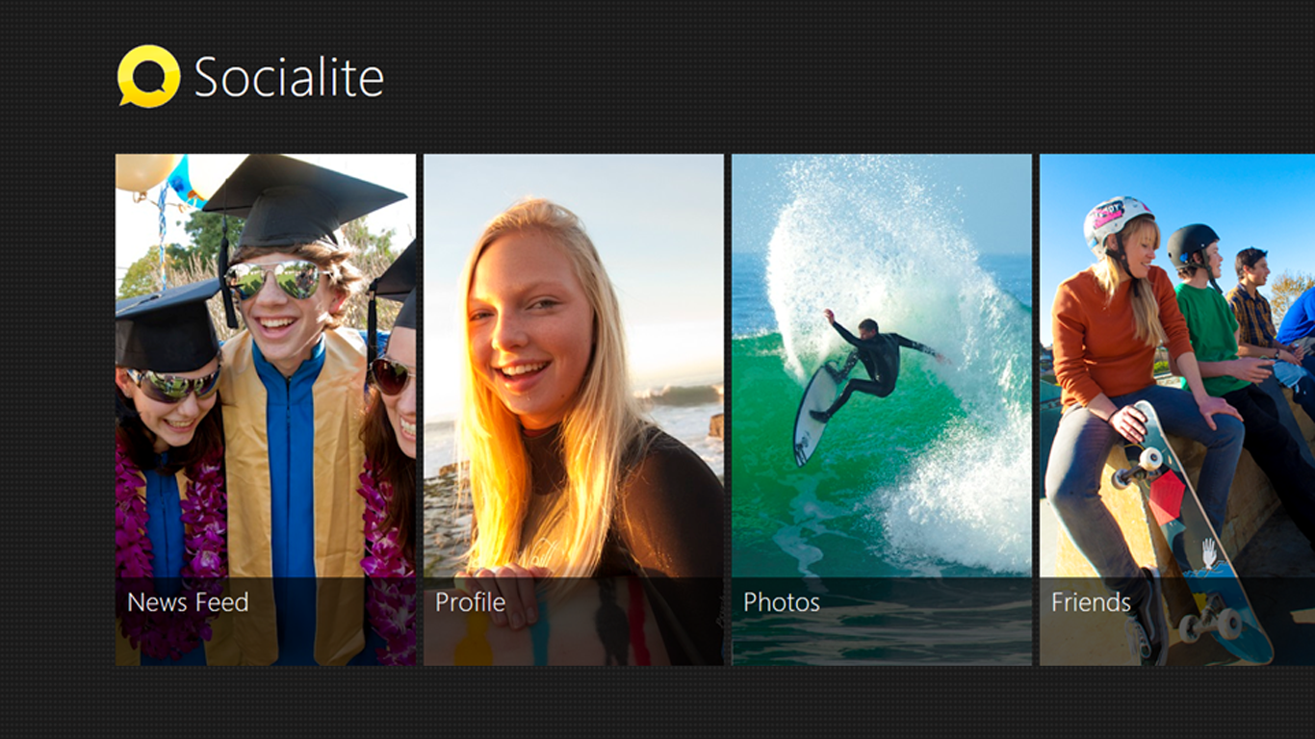
Agenda

Slide 10
Agenda
Metro style design
Page title
Baseline at 100px
Content area
Top aligned at 140px
Silhouette
In the absence of chrome when people are focusing on the content, the formation of the content is what lets people recognize something as Metro style before their eyes even process it. Creating a silhouette is about leveraging negative space and content placement to establish a recognizable form.
Establish common anchors
Identify commonalities between different pages, and present those elements in a consistent manner.
Content area
Left margin 120px
Use a stable rail
When content goes off screen, let it move from edge to edge along a single axis. Let off screen objects peek in and use negative space to create a visual rail.
Create a focal point
Select a hero for your content, and add visual volume to it to make it the first thing that catches people's eyes.

Slide 11
Design & Form-Factors

Slide 12


Slide 13
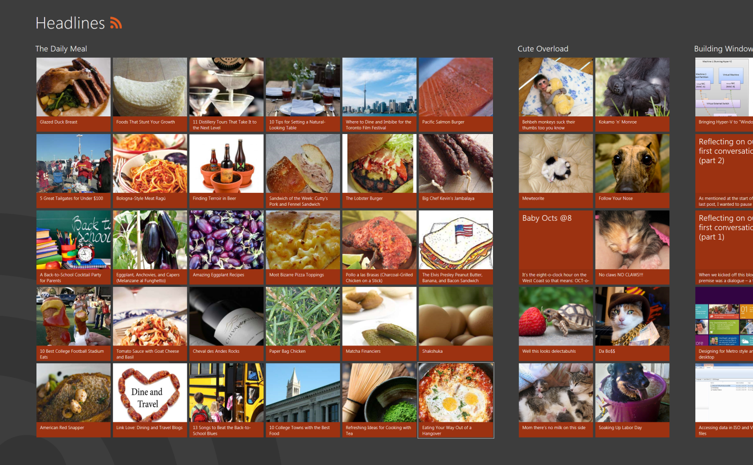
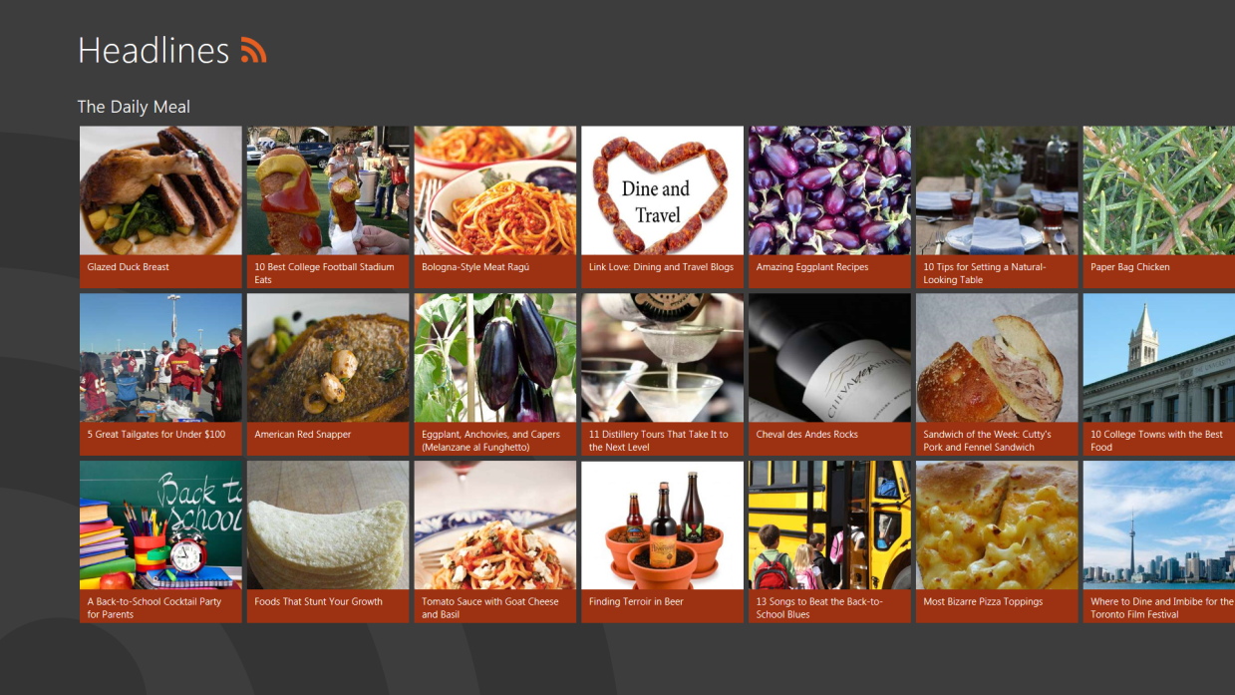
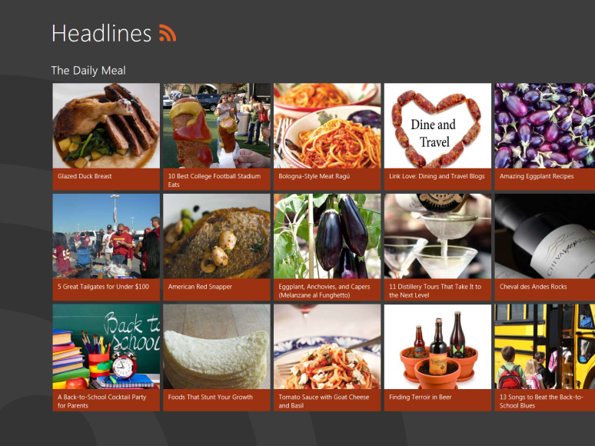
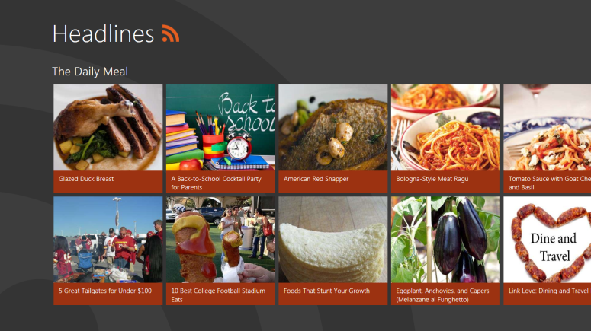
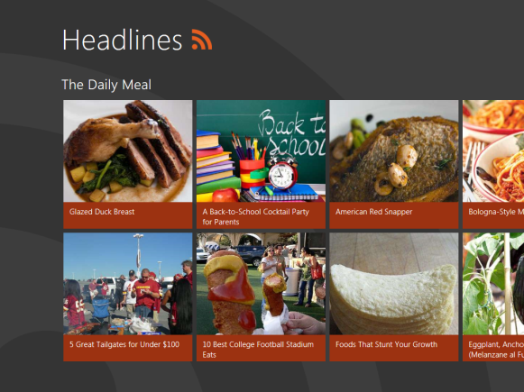
Screen sizes
20” 1920x1080
30” 2560x1600
13” 1400x1050
11.6” 1366x768
10” 1024x768

Slide 14
Scaling
Minimum: 1024x768
Base: 1366x768
“Max”: 2560x1600

Slide 15
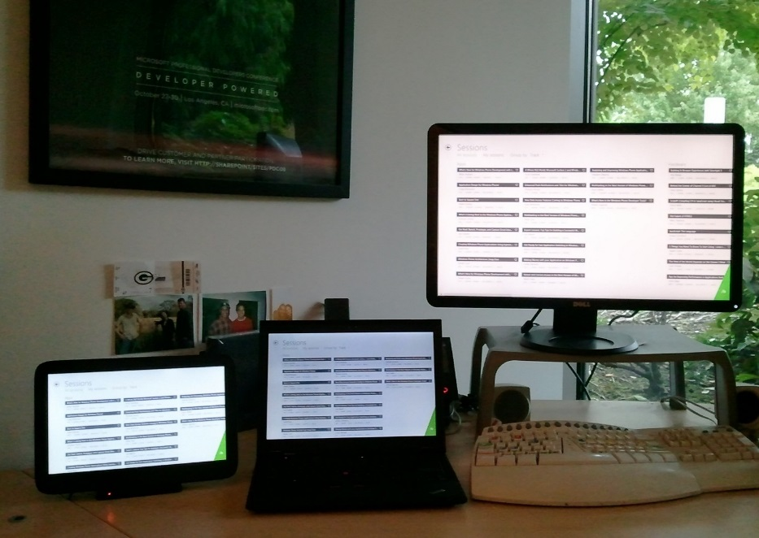
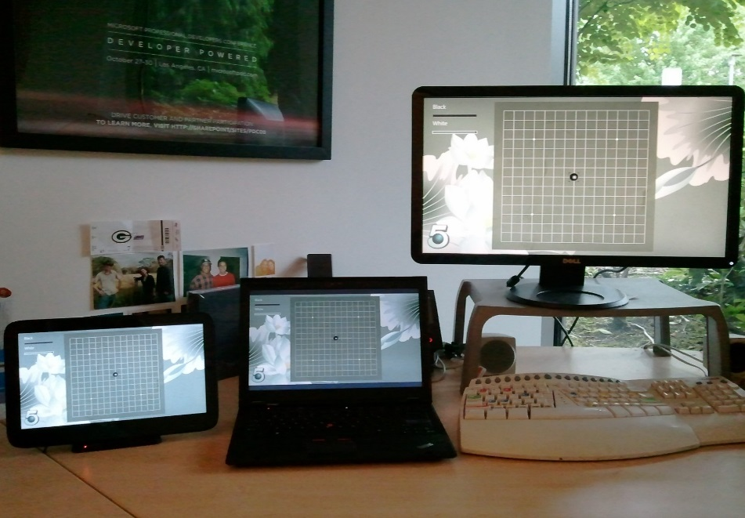
Screen sizes
Adaptive
Fixed

Slide 16


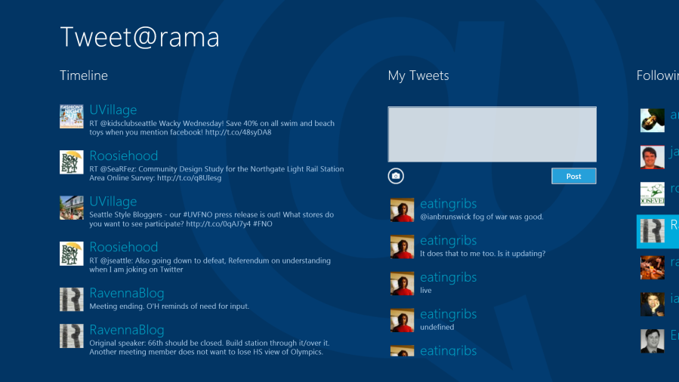
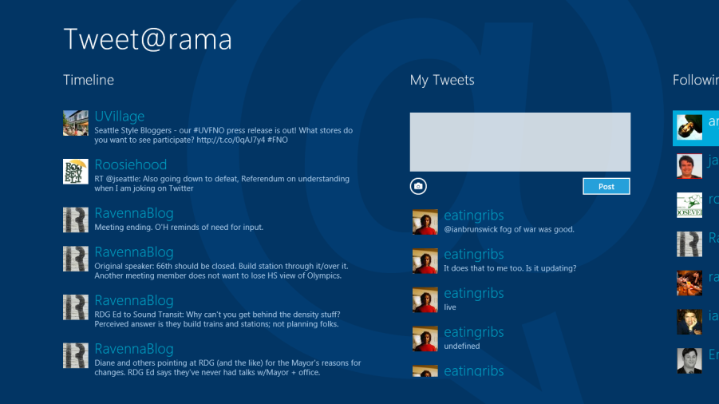
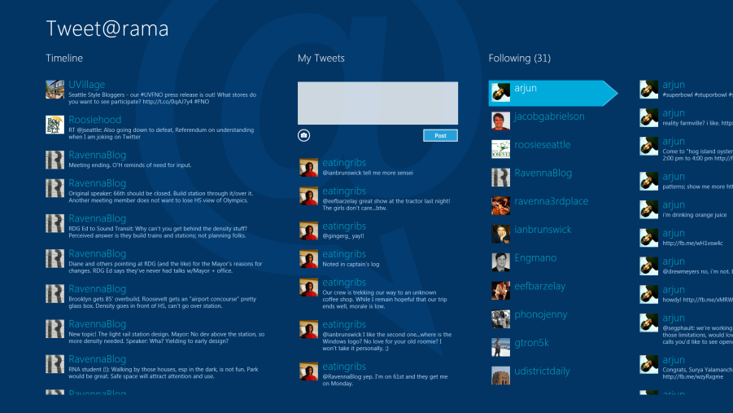
11.6” 1366x768
11.6” 1920x1080

Slide 17
Scaling
11.6” 1366x768 135 dpi
11.6” 1920x1080
190 dpi
11.6” 2560x1440
253 dpi
100%
140%
180%

Slide 18
Demo

